Slide 1

DCF Valuation Model
By Abhishek Modha
June 2025

Slide 2
Business Model Highlights
Sector: Renewable Energy (Solar)
Core Business:
Solar module & cell manufacturing
EPC services (design, install, maintain)
Smart inverters (VAMA series)
Tech Edge:
AI-powered manufacturing & automation
Revenue Streams:
Module sales
EPC contracts
Inverter sales
Financing via YES Bank
Markets:
India + exports to 20+ countries
Growth Plan:
Expanding to 14 GW modules & 4 GW cells by FY27
IPO by 2026
Entry into green hydrogen & aluminium components

Slide 3
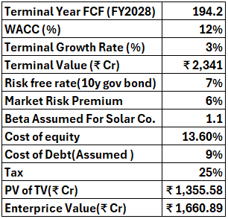
Assumptions
WACC: 12% Reflects the capital-intensive nature of solar manufacturing. Goldi Solar is rapidly expanding module & cell capacity (up to 14 GW), requiring heavy capex and long-term financing. Higher WACC captures project and funding risk.
Beta: 1.1 Assumes moderate correlation with market movements. While Goldi is private, this is aligned with publicly listed solar manufacturers with similar operating risk.
Risk-Free Rate: 7% Based on Indian 10-year government bond yields, representing a stable benchmark for long-term infrastructure-backed projects.
Market Risk Premium: 6% Accounts for equity investor expectations in emerging markets like India, where volatility and inflation premiums are higher.
Terminal Growth Rate: 3% A conservative assumption given Goldi’s strong expansion roadmap. It aligns with India’s long-term inflation + real GDP growth, balancing optimism with prudence.

Slide 4
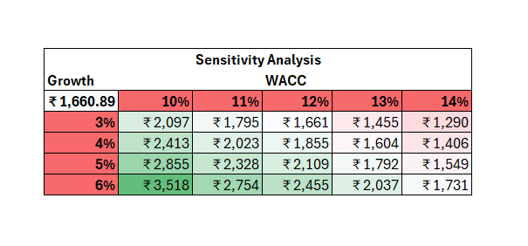
FCF(Free Cash Flow)

